Slide 1
The Evolution of Rock
And other 80s happenings…

Slide 2
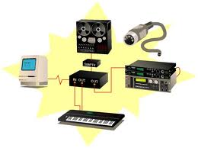
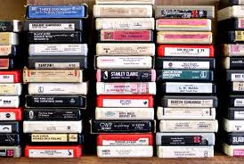
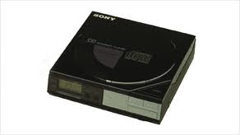
New Technology of Music
CDs
MIDI
Digital Tape Recording
8 Track Tapes – Cassette Tapes
Notes:
Pre-recorded cassettes ruled from 66-79. In 1979, record sales plummet. Researchers blame it on the fact that people were using their record decks to record their friends’ tapes.
Walkman introduced in 1980; huge in 1983
Compact Disc – 1983; greater portability and improved sound; also, non-linear (hit a button and your on next track)
Profit made on CDs b/c cheaper and higher demand – 8 tracks, cassettes and vinyl disappear
MIDI – musical instrument digital interface: a computer protocol that enables digital instruments and computer software to communicate to one another. 1983
keyboard
digital samplers
drum machines
People can record own music at home
Easier to make changes to how music was played back

Slide 3
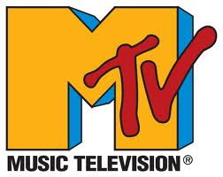
MTV

Slide 4
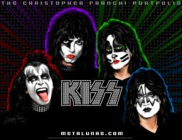
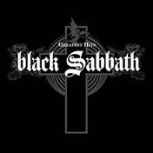
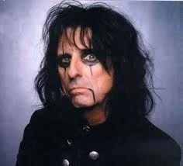
Remember the 70s…

Slide 5
Glam Rock
Glam Rock
Umbrella term encompassing a wide variety of styles whose artists utilized flamboyant fashions and assaults on sexual conventions
Big hair
Make-up
Glamerous
Shock-and-awe factor

Slide 6
Glam Rock
David Bowie
Notes:
VERY creative musician and song writer
First few hit singles, portrays himself as alien
Announces in 1972 interview that he is gay. Develops alter ego Ziggy Stardust, a bisexual alien rock star
Very extravagant concerts and shows; music videos

Slide 7
Glam Rock
Elton John
Notes:
Reginald Kenneth Dwight
Bernie Taupin – together become best writer combo since Lennon McCartney
Since 1970, released 28 top 40 LPs, seven no. 1s; more than 50 top 40 singles, 8 of which went to no. 1
Piano playing, song lyrics not enough – went over the top with outlandish antics on stage and costumes
Also homosexual

Slide 8
Glam Rock
Rod Stewart
Notes:
33 top 40 songs, 4 no. 1s

Slide 9
Transition of Metal
Pop Metal
More commercially oriented version of metal rock
Used keyboards and vocal harmonies
Focused on catchy pop hooks for a wider audience
Thrash / Speed Metal
A faster, darker, more intense metal music
Technically demanding and complex musical compositions

Slide 10
Hair Bands of the 80s
Poison
Notes:
Poison is an American glam metal band that achieved great success in the mid-1980s to mid-1990s. Poison has sold over 30 million records worldwide[1] and have sold 15 million records in the United States alone.[2] The band has also charted ten singles to the Top 40 of the Billboard Hot 100, including six Top 10 singles and the Hot 100 number-one single, "Every Rose Has Its Thorn".[3] The band become icons of the '80s MTV era and have had widespread commercial success. The band's break through debut album, the multi platinum Look What the Cat Dragged In was released in 1986 and they hit their peak with the second album, the multi-platinum selling Open Up and Say... Ahh! which became the band's most successful album. The popularity continued into the new decade with their third consecutive multi platinum selling album Flesh & Blood.
In the 90's following the release of the bands first live album Swallow This Live, the band experienced some line up changes and the fall of Pop Metal with the grunge movement, but despite a drop in popularity the bands fourth studio album Native Tongue still achieved Gold status and the bands first compilation album Poison's Greatest Hits: 1986–1996 went double platinum.
In the 2000s, with the original line up back together, the band found new popularity after a successful greatest hits reunion tour in 1999. The band began the new decade with the release of the long awaited Crack a Smile... and More!, followed by the Power to the People album. The band toured almost every year to sold out stadiums and arenas. They released a brand new album Hollyweird in 2002 and in 2006 the band celebrated their 20 year Anniversary with The Best of Poison: 20 Years of Rock tour and album, which was certified Gold and marked Poison's return to the Billboard 200 top 20 charts for the first time since 1993. Band members have released several solo albums and starred in successful reality TV shows. After 25 years, the band is still recording music and performing.
Since their debut in 1986, they have released seven studio albums, four live albums, five compilation albums, and have issued 28 singles to radio.

Slide 11
Hair Bands of the 80s
Def Leppard
Notes:
Def Leppard are an English rock band formed in 1977 in Sheffield as part of the New Wave of British Heavy Metal movement. Since 1992, the band has consisted of Rick Savage (bass, backing vocals), Joe Elliott (lead vocals), Rick Allen (drums, backing vocals), Phil Collen (guitar, backing vocals), and Vivian Campbell (guitar, backing vocals). This is the band's longest-standing line-up.
The band's strongest commercial success came between the early 1980s and the early 1990s. Their 1981 album High 'n' Dry was produced by Robert John "Mutt" Lange, who helped them begin to define their style, and the album's stand out track "Bringin' On the Heartbreak" became one of the first metal videos played on MTV in 1982. The band's next studio album Pyromania in 1983, with the lead single "Photograph", turned Def Leppard into a household name. In 2004, the album ranked number 384 on Rolling Stone's 500 Greatest Albums of All Time.[8]
Def Leppard's fourth album Hysteria, released in 1987, topped the U.S. and UK album charts. As of 2009 it has 12x platinum sales in the United States, and has gone on to sell over 20 million copies worldwide.[9] The album spawned six hit singles, including the U.S. Billboard Hot 100 number one "Love Bites", alongside "Pour Some Sugar on Me", "Hysteria", "Armageddon It", "Animal" and "Rocket".
Their next studio album Adrenalize (the first following the death of guitarist Steve Clark) reached number one on the U.S. Billboard 200 and UK Album Chart in 1992, and contained several hits including, "Let's Get Rocked" and "Have You Ever Needed Someone So Bad". Their 1993 album Retro Active contained the acoustic hit song "Two Steps Behind", while their greatest hits album Vault released in 1995 featured the new track "When Love & Hate Collide".
As one of the world's best-selling music artists, Def Leppard have sold more than 100 million albums worldwide,[10] and have two albums with RIAA diamond certification, Pyromania and Hysteria.[11] They are one of only five rock bands with two original studio albums selling over 10 million copies in the U.S.[12] The band were ranked No. 31 in VH1's "100 Greatest Artists of Hard Rock"[13] and ranked No. 70 in "100 Greatest Artists of All Time".[14] Def Leppard are currently touring in support of their recently released live album, Mirrorball.[1

Slide 12
Hair Bands of the 80s
Mötley Crüe
Notes:
Mötley Crüe is an American heavy metal band formed in Los Angeles, California in 1981. The group was founded by bass guitarist Nikki Sixx, and drummer Tommy Lee, who were later joined by lead guitarist Mick Mars and lead singer Vince Neil. Mötley Crüe has been described through the years as the World's Most Notorious Rock Band and has sold more than 80 million album copies worldwide,[1][2] including 25 million in the U.S.[3]
The band members have often been noted for their hedonistic lifestyles and the persona they maintained. All of the original members have had numerous brushes with the law, spent time in prison, suffered from alcoholism, suffered from long addictions to drugs, had countless escapades with women and are heavily tattooed. Their ninth studio album, Saints of Los Angeles, was released on June 24, 2008, certified Gold album in January 2012. Motley Crue has been working on their tenth studio album, which is set for release in 2013.[4][5]
Mötley Crüe was ranked tenth on MTV's list "Top 10 Heavy Metal Bands of All-Time" and ninth on "VH1's All Time Top Ten Metal Bands".

Slide 13
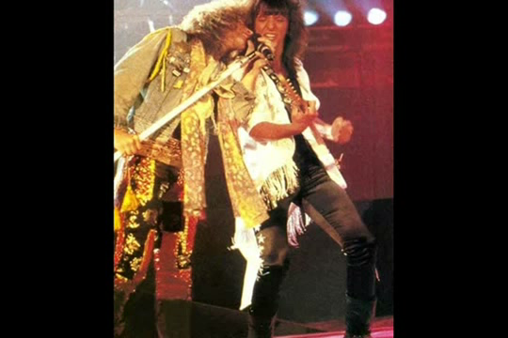
Hair Bands of the 80s
Bon Jovi
Notes:
Bon Jovi is an American rock band from Sayreville, New Jersey. Formed in 1983, Bon Jovi consists of lead singer and namesake Jon Bon Jovi (John Francis Bongiovi, Jr.), guitarist Richie Sambora, keyboardist David Bryan, and drummer Tico Torres.[1] The band's lineup has remained mostly static during its history, the only exception being the 1994 dismissal of bass player Alec John Such, who was unofficially replaced by Hugh McDonald.
Over the years Bon Jovi became one of the most successful bands in rock history in terms of touring the world, music series, and television appearances. In 2011 the band was elected by Rolling Stone magazine as the second most expensive rock band on the planet, bested only by U2. Bon Jovi released only four albums in the 1980s: Bon Jovi, which is the group's debut album; 7800 Farenheit; Slippery When Wet; and New Jersey. Bon Jovi became one of the most famous rock bands of world at that time, and even today it still carries that reputation. From the 1990s onwards the band changed style a few times, never leaving its hard rock band image. In 2010 the band was awarded the MTV Global Icon award. In 2012 the band was sixth in turnover among worldwide artists and bands, as evaluated by Forbes magazine.
In 1986, Bon Jovi achieved widespread global recognition with their third album, Slippery When Wet.[2] The band's fourth album, New Jersey was equally successful in 1988, and between 1986—1995, Bon Jovi had 13 U.S. Top 40 hits, including four No.1's on the Billboard Hot 100: "You Give Love a Bad Name", "Livin' on a Prayer", "Bad Medicine", and "I'll Be There for You". Other Top 10 record chart hits included "Wanted Dead or Alive", "Bed of Roses" and "Always". The success of Bon Jovi's 2000 single, "It's My Life", helped introduce them to a younger audience, as has the use of different styles in their music, such as the appearance of country in 2007's Lost Highway. Lost Highway debuted at number one on the Billboard 200, as did 2009's The Circle. Bon Jovi's latest album, What About Now, will be released in 2013.[3]
Thus far, Bon Jovi has released 11 studio albums, plus three compilations and two live albums. They have sold 130 million records worldwide,[4] and performed more than 2,700 concerts in over 50 countries for more than 35 million fans.[5] Bon Jovi was inducted into the UK Music Hall of Fame in 2006.[6] The band was also honored with the Award of Merit at the American Music Awards in 2004,[7] and as songwriters and collaborators, Jon Bon Jovi and Richie Sambora were inducted into Songwriters Hall of Fame in 2009.

Slide 14
Hair Bands of the 80s
Van Halen
Notes:
Van Halen is an American hard rock band formed in Pasadena, California, in 1972. Its 1978 debut album, Van Halen—featuring guitarist Eddie Van Halen, vocalist David Lee Roth, drummer Alex Van Halen, and bassist Michael Anthony—is widely considered to be among the most "original" and "revolutionary" albums to "change rock and roll."[1]
According to the Recording Industry Association of America, Van Halen is the 19th best-selling band/artist in United States history, with sales of over 56 million albums in the U.S. and over 86 million albums worldwide, (with the band's former record company, Warner Bros. Records, last certifying Van Halen's albums in 2004.)[2][3] Van Halen is one of only five rock bands that have had two albums sell more than 10 million copies in the U.S.[4] Additionally, Van Halen has had the most #1 hits in the history of Billboard's Mainstream Rock chart.[5]
In addition to Van Halen's many popular songs, the band is known for the drama surrounding the exits of former members. The multiple exits of lead singers David Lee Roth, Sammy Hagar and Gary Cherone were surrounded in controversy and press coverage, including numerous conflicting press statements between the former singers and the band. Following their 2004 concert tour the band was on a hiatus from the public until September 2006, when new bassist Wolfgang Van Halen's place was confirmed and Roth reunion rumors began to re-surface, both events coinciding with the band's Rock and Roll Hall of Fame induction on March 12, 2007.[6] After years of speculation, Van Halen began a tour with Roth across North America in 2007 and into 2008. On December 26, 2011, Van Halen announced a tour for 2012, and released their first album in 14 years, A Different Kind of Truth, on February 7, 2012.[7

Slide 15
The Ballad
Trademark of heavy metal bands of the 80's that is making a comeback. an acoustic rock song with heavy guitar.
Sang, not screamed
Ladies LOVED these songs
Played at prom between 1981-95

Slide 16
The Ballad
Journey – Open Arms
REO Speedwagon – Keep on Loving You
Notes:
Journey is an American rock band formed in 1973 in San Francisco by former members of Santana and Frumious Bandersnatch. The band has gone through several phases; its strongest commercial success occurred between 1978 and 1987, after which it temporarily disbanded. During that period, the band released a series of hit songs, including 1981's "Don't Stop Believin'", which became in 2009 the top-selling catalog track in iTunes history.[2][3][4] Its parent studio album, Escape, the band's eighth and most successful, reached No. 1 on the Billboard 200 and yielded another of their most popular singles, "Open Arms". Its 1983 follow-up, Frontiers, was almost as successful in the United States, reaching No. 2 and spawning several successful singles; it broadened the band's appeal in the United Kingdom, where it reached No. 6 on the UK Albums Chart. Journey enjoyed a successful reunion in the mid-1990s, and later regrouped with a series of lead singers.
Sales have resulted in two gold albums, eight multi-platinum albums, and one diamond album (including seven consecutive multi-platinum albums between 1978 and 1987). They have had eighteen Top 40 singles in the US, six of which reached the Top 10 of the US Billboard Hot 100 chart and two of which reached No. 1 on other Billboard charts, and a No. 6 hit on the UK Singles Chart in "Don't Stop Believin'". Originally a progressive rock band, Journey was described by Allmusic as having cemented a reputation as "one of America's most beloved (and sometimes hated) commercial rock/pop bands" by 1978, when they redefined their sound by embracing traditional pop arrangements on their fourth album, Infinity.[5] According to the Recording Industry Association of America, Journey has sold 47 million albums in the US, making them the 28th best selling band. Their worldwide sales have reached over 80 million albums.[6][7] A 2005 USA Today opinion poll named Journey the fifth best American rock band in history.[8][9] Their songs have become arena rock staples and are still played on rock radio stations across the world.

Slide 17
Thrash Metal
Judas Priest
Megadeth
Notes:
Judas Priest are a British heavy metal band formed in Birmingham, England in 1969.[1] Known for twin lead guitars, a wide operatic vocal style, and for introducing the S&M leather-and-studs look into heavy metal, they have sold over 50 million albums worldwide.[2][3][4]
After an early career as a secondary act dogged by unsympathetic producers and line-up changes, the band found considerable commercial success in the 1980s. In 1989, they were named as defendants in an unsuccessful lawsuit alleging that subliminal messages on their albums had caused the suicide attempts of two young men.[5]
The band's membership has seen much turnover, including a revolving cast of drummers in the 1970s, and the temporary departure of singer Rob Halford in the early 1990s. The current line-up consists of lead vocalist Rob Halford, guitarists Glenn Tipton and Richie Faulkner, bassist Ian Hill, and drummer Scott Travis. The band's best-selling album is 1982's Screaming for Vengeance featuring their most commercially successful line-up, Rob Halford (lead vocals), K. K. Downing (guitar), Glenn Tipton (guitar), Ian Hill (bass), and Dave Holland (drums). In 2010, the band announced that a new album is expected to be released sometime in 2013.

Slide 18
Alternative Rock
Umbrella term encompassing a wide variety of stylistic approaches with a decidedly independent attitude
Influences from punk, psychodelia, folk and hard rock
More mature college audiences

Slide 19
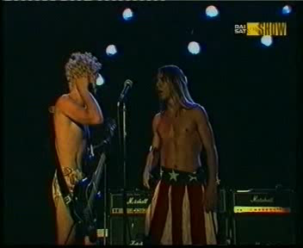
Alternative Rock
R.E.M.
Red Hot Chili Peppers

Slide 20
The Other Happenings in Rock Music

Slide 21
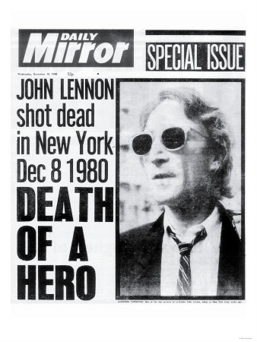
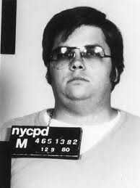
John Lennon
Notes:
Double Fantasy – album recorded by Lennon and Ono in 1980
He and Ono walking home from late-night recording session, deranged fan Mark David Chapman shoots Lennon.
Uncertainty to future of rock n roll

Slide 22
PMRC
Parents Music Resource Center
“to educate and inform parents of alarming trend…towards lyrics that are sexually explicit.”
Notes:
Created 1985
“Washington Wives” (Tipper Gore, Al’s wife)
Religious and conservative backing
RIAA Recording Industry Assc of America asks record companies to put labels on CDs.

Slide 23
Pop Music (Not MJ, Madonna or Prince)
Huey Lewis and the News
Whitney Houston
Paula Abdul
Janet Jackson
Phil Collins

Slide 24
The Biggest Scam in Music History

Slide 25
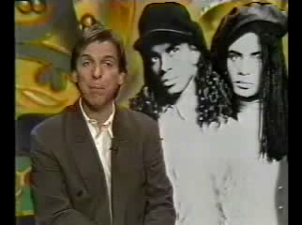
The Biggest Scam in Music History
Notes:
Rob Pilatus and Fabrice Morvan
Lip synced their hit songs
Grammy Awards in 1990, revoked and stripped by association in 1990
Shows how “image conscious” Americans were in the MTV decade
Pilatus commits suicide in 1998

Slide 26
Charity Rock
“We Are the World”
Live Aide
Farm Aid
Notes:
Written by MJ and Quincy Jones, benefit song for USA for Africa (relief org.)
“Check your egos at the door.”
45 hit artists got togther at A&M studios in Hollywood to record song in 1985 – stays at no. 1 for 4 weeks
Simulatenous concerts held in Philly and London. Africa relief project. Raised $100 million.
Willie Nelson’s idea for awareness for struggling farm industry. 1985

